Slide 1
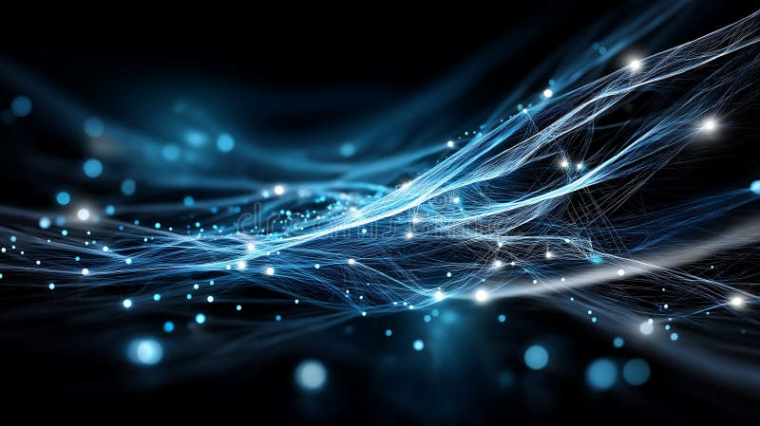
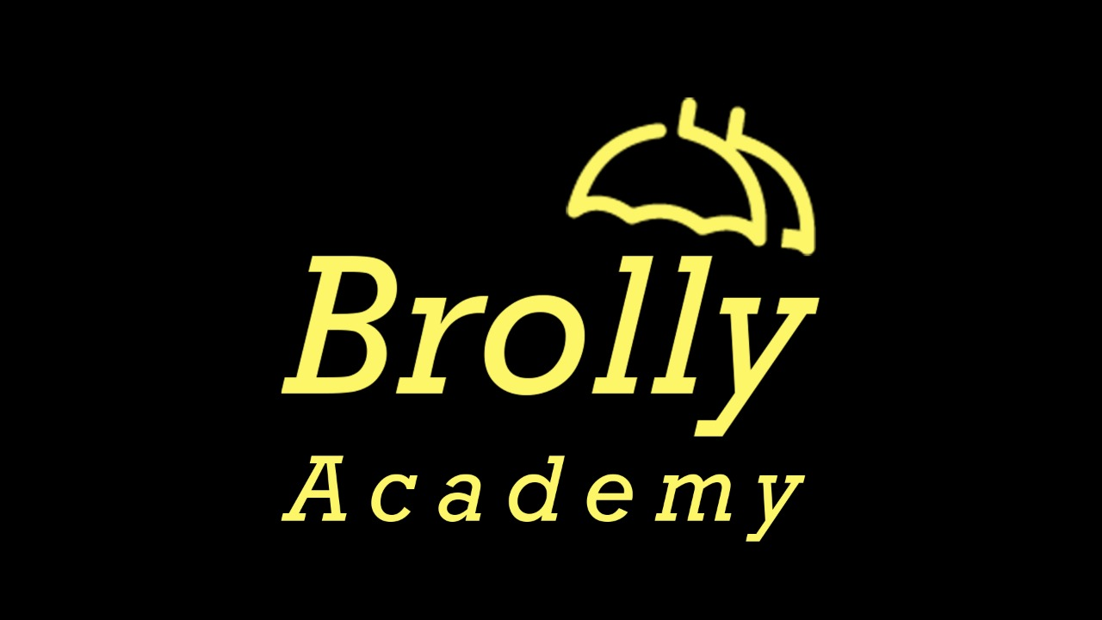
BROLLY ACADEMY PRESENTS
GENERATIVE
AI MODELS
A Complete Guide to Types, Use Cases,
Risks & Future Trends
2026 EDITION

Slide 2
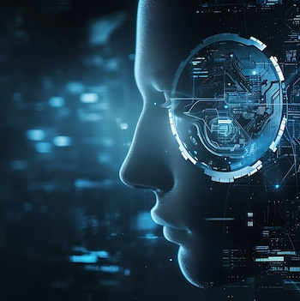
What Are Generative AI Models?
Advanced AI systems that learn patterns from massive datasets to create entirely new content — text, images, videos, music, code, and 3D assets.
Unlike traditional AI that classifies or predicts, generative AI creates original outputs that resemble human-created content using deep learning and neural networks.
KEY PLATFORMS
ChatGPT
Gemini
Claude
Midjourney
Stable Diffusion
THE GENERATIVE AI PIPELINE
Data Collection
Preprocessing
Architecture
Training
Fine-Tuning
Inference
Evaluation
Deployment
GENERATIVE AI VS TRADITIONAL AI
Feature | Traditional AI | Generative AI
Main Job | Predicts outcomes | Creates new content
Output | Labels or numbers | Text, image, audio, video
02

Slide 3
6 Types of Generative AI Models
VAEs
GANs
Autoregressive
Smart compressors that squish data into latent space, then expand back. Best for image compression and medical imaging.
Two neural networks compete — Generator creates fakes, Discriminator catches them. Produces extremely realistic visuals.
Predicts the next token step-by-step. Each word depends on previous ones. Powers GPT series for writing and code.
Diffusion Models
Flow-Based
Transformers
Starts with random noise and iteratively denoises into stunning images. Powers DALL-E, Stable Diffusion, Midjourney.
Uses invertible transformations for exact likelihood calculations. Best for audio synthesis and density estimation.
The king of modern AI. Uses attention mechanism to understand relationships across entire documents. Highly scalable.
TOP LLMs COMPARED (2026)
Model | Company | Parameters | Specialty | Open Source
GPT-4o | OpenAI | ~1.8T (est.) | Multimodal, reasoning | No
Claude 3.5 | Anthropic | Unknown | Long context, safety | No
Llama 3 | Meta | 70B - 405B | Open-source AI | Yes
03

Slide 4
Applications, Risks & The Road Ahead
REAL-WORLD APPLICATIONS
RISKS & CHALLENGES
FUTURE TRENDS
Image Generation
Midjourney, DALL-E, Stable Diffusion
Deepfakes & Misinformation
Fake videos, photos, voice recordings
Real-Time Multimodal AI
AI that sees, hears, responds instantly
Content Writing
ChatGPT, Claude, Jasper
Data Privacy & Leakage
Personal info exposure, trade secrets
AI + Robotics
Physical robots controlled by LLMs
Code Generation
GitHub Copilot, Cursor, Replit AI
AI Bias & Discrimination
Unfair outputs by race, gender, language
AI Video Explosion
Hollywood-quality from simple scripts
Video Generation
Sora, Runway ML, Pika Labs
Copyright & IP Issues
Lawsuits from artists and publishers
Autonomous AI Agents
AI that plans and executes tasks
Healthcare
Drug discovery, medical scan analysis
High Compute Costs
Expensive training and infrastructure
Quantum AI Possibilities
Millions of times faster training
Education
Personalized AI tutors, adaptive learning
BEST PRACTICES FOR AI ADOPTION
Do: Start small with one use case. Always review AI outputs. Train your team on prompt engineering. Use enterprise AI with privacy built-in.
Don't: Share sensitive data with public AI. Publish AI content without review. Use AI for critical decisions without oversight. Assume AI is always right.
04

Slide 5

START YOUR AI JOURNEY
Join Brolly Academy and master the future of technology
VISIT US
Metro Pillar No: A689, JNTU Metro Station, 3rd Floor,
Dr Atmaram Estates, beside Sri Bhramaramba Theatre,
Hyder Nagar, Vasantha Nagar, Hyderabad, Telangana 500072
CALL US
+91 81868 44555
MAIL US
brollyacademy@gmail.com
www.brollyacademy.com

